Slide 1
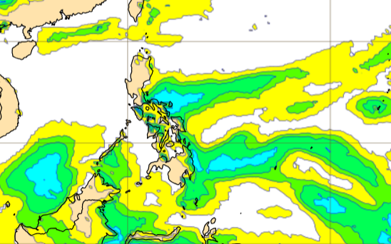
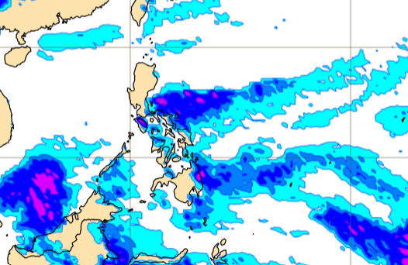
Welcome! ECWMF Data processing workshop 11th -12th January 2023

Slide 2
Training Objectives
Introduce the products that are available on ECWMF license.
To be able to learn the proper handling of the ECMWF data such as file exploration, processing and visualization.

Slide 3
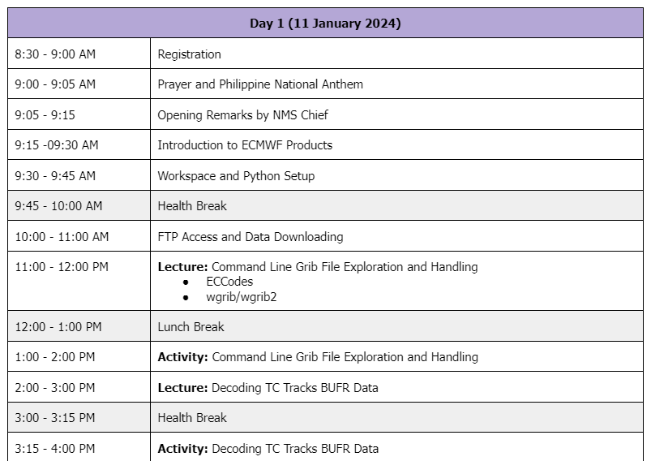
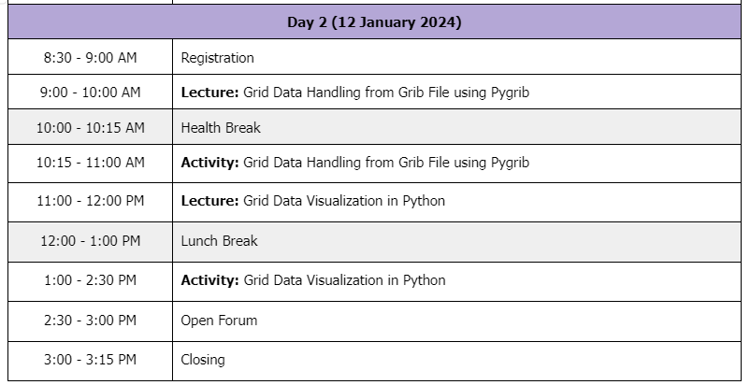
Agenda

Slide 4
Introduction to ECMWF Products
ECMWF
Catalogue of ECMWF real time data
IFS
Products available
License: terms and conditions | update

Slide 5
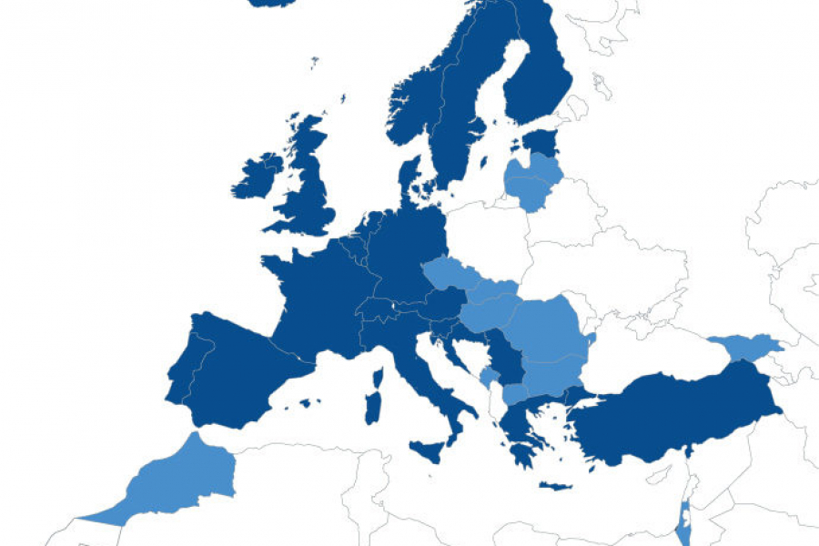
European center for medium range weather forecasting (ECMWF)
Independent intergovernmental organization supported by 35 states.
Research institute
24/7 operational service - produce global numerical weather forecast (HRES and ENS) and real time dissemination to different destinations worldwide.
ECMWF offers catalogue of forecast that can be purchased and offered for free (e.g. WMO essential products, Open data policy)
https://www.ecmwf.int/en/about
Notes:
24/7 operational service – produce global numerical weather forecast for our users worldwide.

Slide 6
Catalogue of ecmwf real-time products
High resolution deterministic forecast
● Atmospheric Model high Resolution 10 day forecast (HRES)
● Ocean Wave Model high resolution 10-day Forecast (HRES-WAM)
Extended range forecast
● Atmospheric Model Ensemble extended forecast (ENS extended)
Seasonal forecast
● Seasonal 7-months forecast (SEAS)
Ensemble forecast
● Atmospheric model Ensemble 15-day forecast (ENS)
Ocean Wave Model Ensemble extended range forecast (ENS-WAM)
Notes:
Update information here:

Slide 7
Integrated Forecasting System (IFS)
Satellite Data and Conventional observations
Data assimilation
Earth system model
(Atmosphere, ocean waves, ocean and ice, land surface)
Forecasting system
(medium range, extended range, long range)
where all the operational forecast are produced.
It includes a sophisticated data assimilation system and global numerical model of the Earth System, as well as supporting infrastructure to make forecast products available to users.
The data assimilation system combines the latest weather observation with a recent forecast to obtain the best possible estimate of the current state of the Earth System - known as analysis.

Slide 8
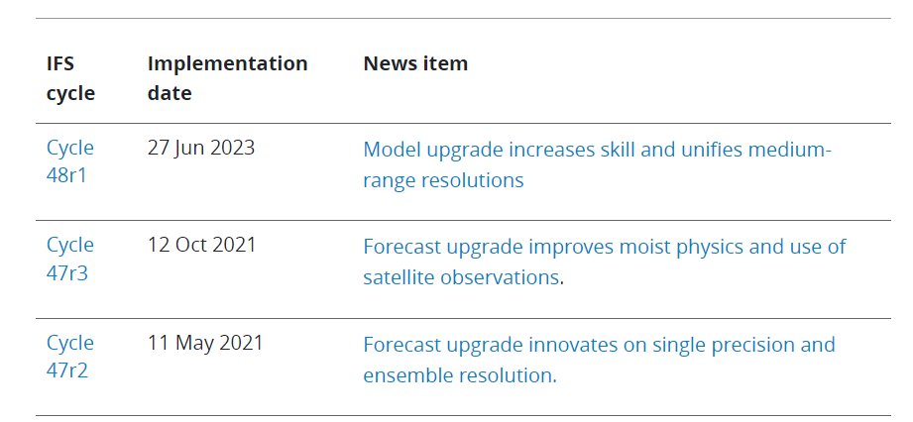

Evolution of IFS
Notes:
Part of the license to to test IFS cycle .

Slide 9
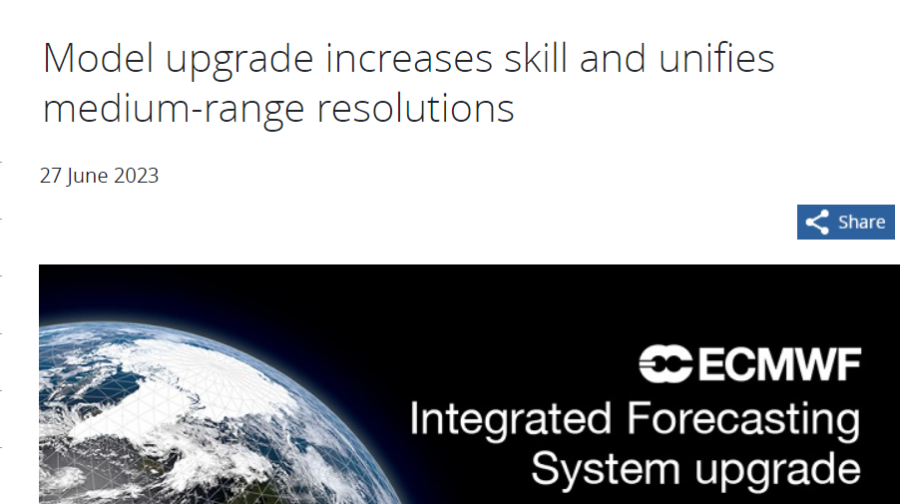
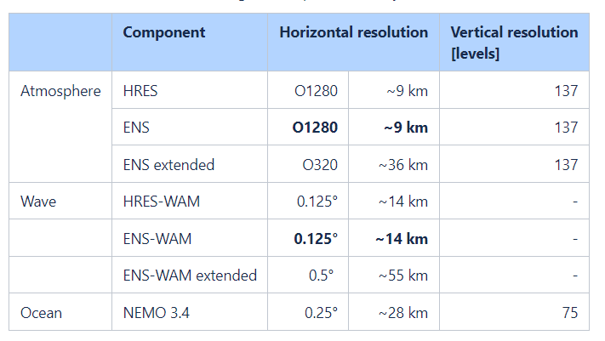
Cycle 48r1
Implemented in 27th June 2023 , improved skill in weather predictions and increased the resolution medium range ENS.
ENS resolution ➔ from 18km to 9km
ENS extended ➔ twice a week at day 15 to daily at 00 UTC up to 46 days with 101 members
Test data for cycle upgrades can be delivered by ECWMF upon request
(under Gold package)
https://www.ecmwf.int/en/about/media-centre/news/2023/model-upgrade-increases-skill-and-unifies-medium-range-resolutions

Slide 10
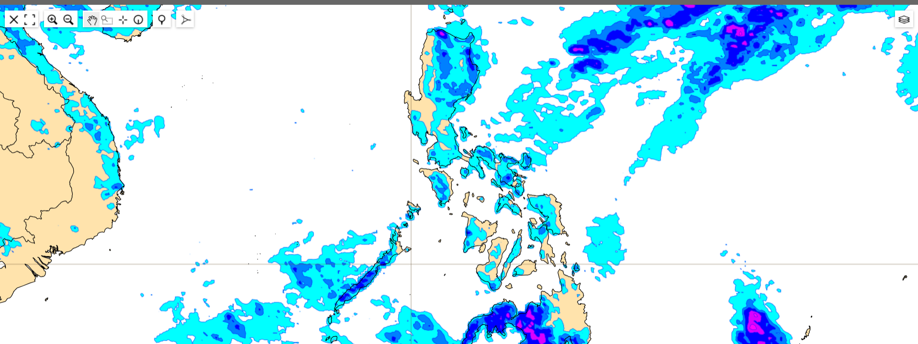
ECMWF Products: NMHS Non-commercial license

Slide 11
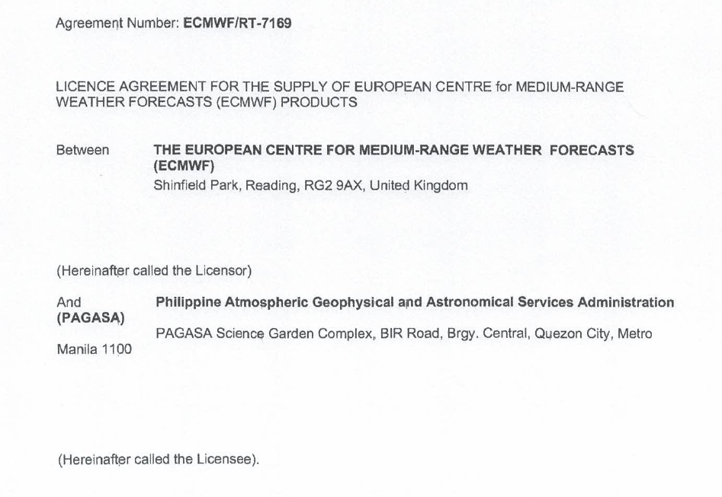

LICENSE AGREEMENT
Signed : 30 November 2023
Agreement Type: NMHS Non- Commercial
Cost: EUR 20,000
Package: GOLD
Data Vol: 50-100 GB per day
Purpose:
https://www.ecmwf.int/en/forecasts/access-forecasts/use-cases-and-licence-conditions/guidelines-interpretation-rules-and

Slide 12
High RES forecast
ATMOSPHERIC Model High Resolution forecast : Pressure level products
Seven (7) Pressure levels: 200,300,400,500,700,850 and 925
Relative Humidity
Temperature
Wind
Vertical Velocity
Geopotential Height
ATMOSPHERIC Model High Resolution (HRES): Single level products
Precipitation
Wind
Temperature
Clouds
Indices
OCEAN WAVE MODEL high resolution (HRES-WAM) products
Notes:
First we have the high resolution forecast products: We have requested the Atmospheric HRES: ECMWFS highest resolution and the Ocean Wave Model High resolution or HRES-WAM which is a wave model coupled to the atmospheric model HRES.
The high resolution atmospheric products is probably the most known and most used products since they are recognizable and easy to interpret. These are products in one single level and or multiple pressure levels, as we are describing the entire atmosphere not just one layer. But single layer products are majority and they are the most widely used. There are over 130 products available, some commonly known of course include clouds, temperature, wind, precipitation types, and other specialized products such as indices. Only subset of parameters are available on multiple levels, these include for example temp, wind, geopotential height, vertical velocity. These products are available on 137 vertical levels, and 25 pressure levels.
Then we have the Ocean Wave Model high resolution forecast or HRES-WAM.
The HRES-WAM or Wave Model is coupled to the atmospheric model HRES.
Only subset of paramters are available on multiple levels -> available in 137 model levels and 25 pressure levels.

Slide 13
High RES forecast
Single level | 35 single level products plus HRES TC Tracks
Base times | 00,06,12,18
Grid | 0.1
Forecast time-steps | 00 & 12 : 0 to 90 by 1, 93 to 144 by 3, 150 to 168 by 6. 06 & 18: 0 to 90 by 1
Areas | 40N, -5S, 100W, 160E
Atmospheric Model High Resolution Deterministic Forecast
4x a day
9 km resolution
137 vertical levels
Up to seven (7) days
Pressure level | 6 products for 7 PLs (200,300,400,500,700,850,925)
Base times | 00,06,12,18
Grid | 0.1
Forecast time-steps | 00 & 12 : 0 to 90 by 1, 93 to 144 by 3, 150 to 168 by 6. 06 & 18: 0 to 90 by 1
Areas | 40N, -5S, 100W, 160E

Slide 14
High RES forecast
Ocean Wave Model High Resolution Forecast
4x a day
9 km resolution
Up to seven (7) days
Single level | 20 waves fields products
Base times | 00,06,12,18
Grid | 0.1
Forecast time-steps | 00 & 12 : 0 to 90 by 1, 93 to 144 by 3, 150 to 168 by 6. 06 & 18: 0 to 90 by 1
Areas | 40N, -5S, 100W, 160E
Notes:
Despite the ecmwf model is considered one of the best in the world, HRES products should not be used alone, besides the DA system one thing that makes ECMWF great is their ensemble prediction system.

Slide 15
ENSEMBLE
Why ensemble forecasting?
NWP cannot consistently or precisely produced correct forecast, there must be some uncertainty in the result of each forecast. If we could know the value of this uncertainty beforehand, it will greatly enhanced the value of the weather forecast.
The ECMWF forecast ensemble is based on the idea that incorrect forecast is the combination of the initial analysis errors and model deficiencies.
Forecast model can produced incorrect result because of initial condition uncertainties like lack of observations, observation errors, errors in the data assimilation, and model uncertainties like limited resolution, weaknesses in the parametrization, or physical processes.

Slide 16
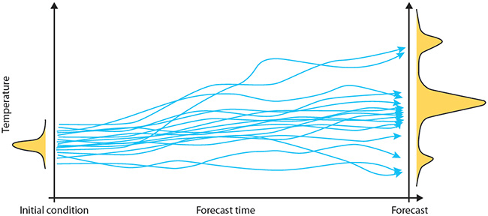
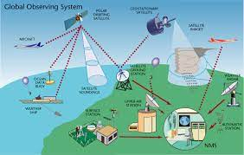
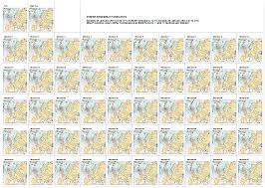
ENSEMBLE
Ensemble forecast
→ Parallel set of forecast from very slightly conditions and model formulations
→ Assess uncertainty in the forecast
Why ensemble?
The atmosphere is a chaotic system
→ We cannot perfectly measure the current state of the atmosphere
→ Small errors can grow to have major impact
https://www.youtube.com/watch?v=TGWt8JfrzYk
Notes:
Since NWP cant produce consistent or precise forecast, there must be some uncertainties in the result of the forecast. If we could know the value of this uncertainty, it will greatly enhance the value of the weather forecast.
The ECMWF forecast ensemble is based on the idea that incorrect forecast is the combination of the initial analysis errors and model deficiencies.
Forecast model can produced incorrect result because of initial condition uncertainties like lack of observations, observation errors, errors in the data assimilation, and model uncertainties like limited resolution, weaknesses in the parametrization, or physical processes.
To estimate the effect of possible initial analysis error, an ensemble is formed from 50 perturbed initial states and 1 unperturbed analysis. And then model is run for each of the analysis as the starting point given a range of forecast results.
In the diagram, compared to initial condition,
This means that it is sensitively dependent on initial conditions. In a chaotic system, a slight change in the input conditions can lead to a significant change in the output forecast. In a non-chaotic system, small differences in initial conditions only give small differences in output. Hence, it is important in weather forecasting to investigate how sensitive the atmosphere is at any stage to initial conditions. Ensemble forecasting does this by looking at a spread of possible outcomes.

Slide 17
ENS Products
ATMOSPHERIC ENS High Resolution Forecast
2x a day
9 km resolution
Up to seven (7) days
Single level | 31 ENS products plus ENS TC Tracks
Base times | 00,12
Grid | 0.1
Forecast time-steps | 00 & 12 : 0 to 144 by 3, 150 to 168 by 6
Areas | 40N, -5S, 100W, 160E

Slide 18
ENS Products
Ocean Wave Model High Resolution Forecast
2x a day
9 km resolution
Up to seven (7) days
Single level | 20 HRES-WAM products
Base times | 00,12
Grid | 0.1
Forecast time-steps | 00 & 12 : 0 to 90 by 1, 93 to 144 by 3, 150 to 168 by 6.
Areas | 40N, -5S, 100W, 160E

Slide 19
ENS up to extended range
Single & Pressure levels | 3 Single level parameters | 3 pressure level parameters ( 200,500,700 and 850).
Base times | Mon, Thursday
Grid | 0.4
Forecast time-steps | Single level – 0 to 1104 by 6 Pressure level - 0 to 1104 by 12
Areas | 40N, -5S, 100W, 160E
Atmospheric ENS extended – Single Level
0.4 x 0.4 grid
46 days ; by 6
Atmospheric ENS extended – Pressure Level
0.4 x 0.4 grid
46 days by
Notes:
Despite the ecmwf model is considered one of th ebest in the world, Hres products should not be used alone, besides the DA system one thing that makes ecwmf great is ther ensemble prediction system.
Only subset of paramters are available on multiple levels -> available in 137 model levels and 25 pressure levels.

Slide 20
SEASONAL FORECAST
SEAS products comprise of ensembles of individual forecast coupled to an ocean model and post processed products of average conditions
Available up to 7 months
Temperature
Wind
Geopotential Height
Monthly means of individual ensemble members – Single level; every 5th of the month ( 7 months)
Wave seasonal forecast 24 hourly - every 5th of the month ( 30 days forecast)
Wave monthly means - every 5th of the month ( 4 months)
0.4 grid
Notes:
Despite the ecmwf model is considered one of th ebest in the world, Hres products should not be used alone, besides the DA system one thing that makes ecwmf great is ther ensemble prediction system.
Only subset of paramters are available on multiple levels -> available in 137 model levels and 25 pressure levels.

Slide 21
ISSUES
Issues | Solution
Slow data transfer | Increase concurrent connection to max of 25
 | Additional IP using PREGINET

Slide 22
THANK YOU!

Slide 23
ECMWF Products included in the licence
High resolution deterministic forecast
● 2x per day
● 9km horizontal resolution
● 137 vertical levels
● 10 days ahead
Ensemble forecast
● 2x per day
● 51 members  9 km horizontal resolution
● 91 vertical levels
15 days ahead
Extended range forecast
● 2x a week (Mon/Thurs)
● 100 members
● ~36km horizontal resolution
● 91 vertical levels
● 46 days ahead
Seasonal forecast
● Once a month
● 51 members
● ~80km horizontal resolution
● 91 vertical levels
● 7 months ahead
Notes:
Update information here:

